Slide 1
Conditional Generative Models for Network Attack Synthesis
Team 11: Richard Linn, Frederick Tania-Amanda
CS 5331 - Generative AI Final Project
November 14, 2025

Slide 2
Project Objective
Real Attack Data
NSL-KDD Dataset
Conditional Model
C-VAE / C-GAN
Synthetic Data
Generated Data
DoS
Probe
R2L
U2R
Notes:
Tania
The project focuses on using conditional generative models to create realistic synthetic network attacks on-demand.. The idea is to train models that can generate specific types of attacks when we tell them to - like saying 'generate a DoS attack' or 'generate a Probe attack.' We will be comparing two approaches we learned in class: Conditional VAE and Conditional GAN. This is an application of generative AI to network security.

Slide 3
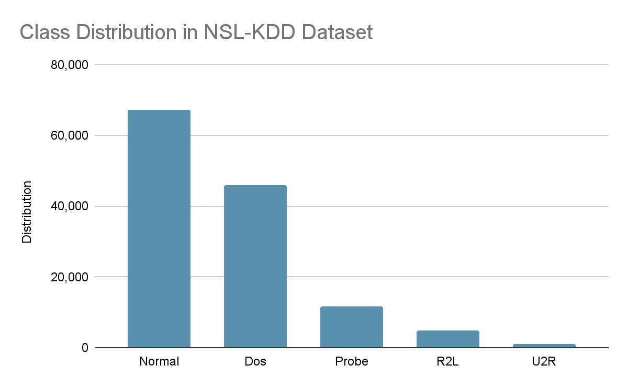
The Problem: Limited Security Data
Real attack data exhibits severe class imbalance
Rare attack types have very few actual samples
Datasets become outdated quickly
Synthetic data can safely augment small attack classes
Generative models create diverse and privacy-safe data
Notes:
Tania
The motivation comes from real problems in network security. When training ML or RL models for intrusion detection, we face major data issues. Some attack types are super rare - like User-to-Root attacks might only have a few hundred examples while normal traffic has millions. We also can't easily share real attack data because of privacy concerns. Generative models from this class - VAEs and GANs - can help by creating synthetic but realistic attack data. This is especially useful for RL research where agents need diverse training scenarios

Slide 4
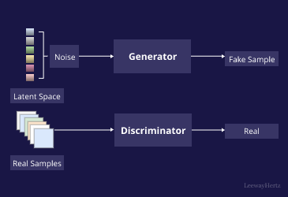
Hypothesis
Conditional generative models (C-VAE and C-GAN) can generate distinguishable, realistic network attack patterns that match specified attack types
C-GAN will produce more realistic samples than C-VAE due to adversarial training
(Takyar, LeewayHertz)
Notes:
Richard
We hypothesize that conditional generative models (C-VAE and C-GAN) can generate distinguishable, realistic network attack patterns that match specified attack types.
Based on what we learned in class, C-GAN will produce more realistic samples than C-VAE because of the adversarial training, though C-VAE might be more stable.

Slide 5
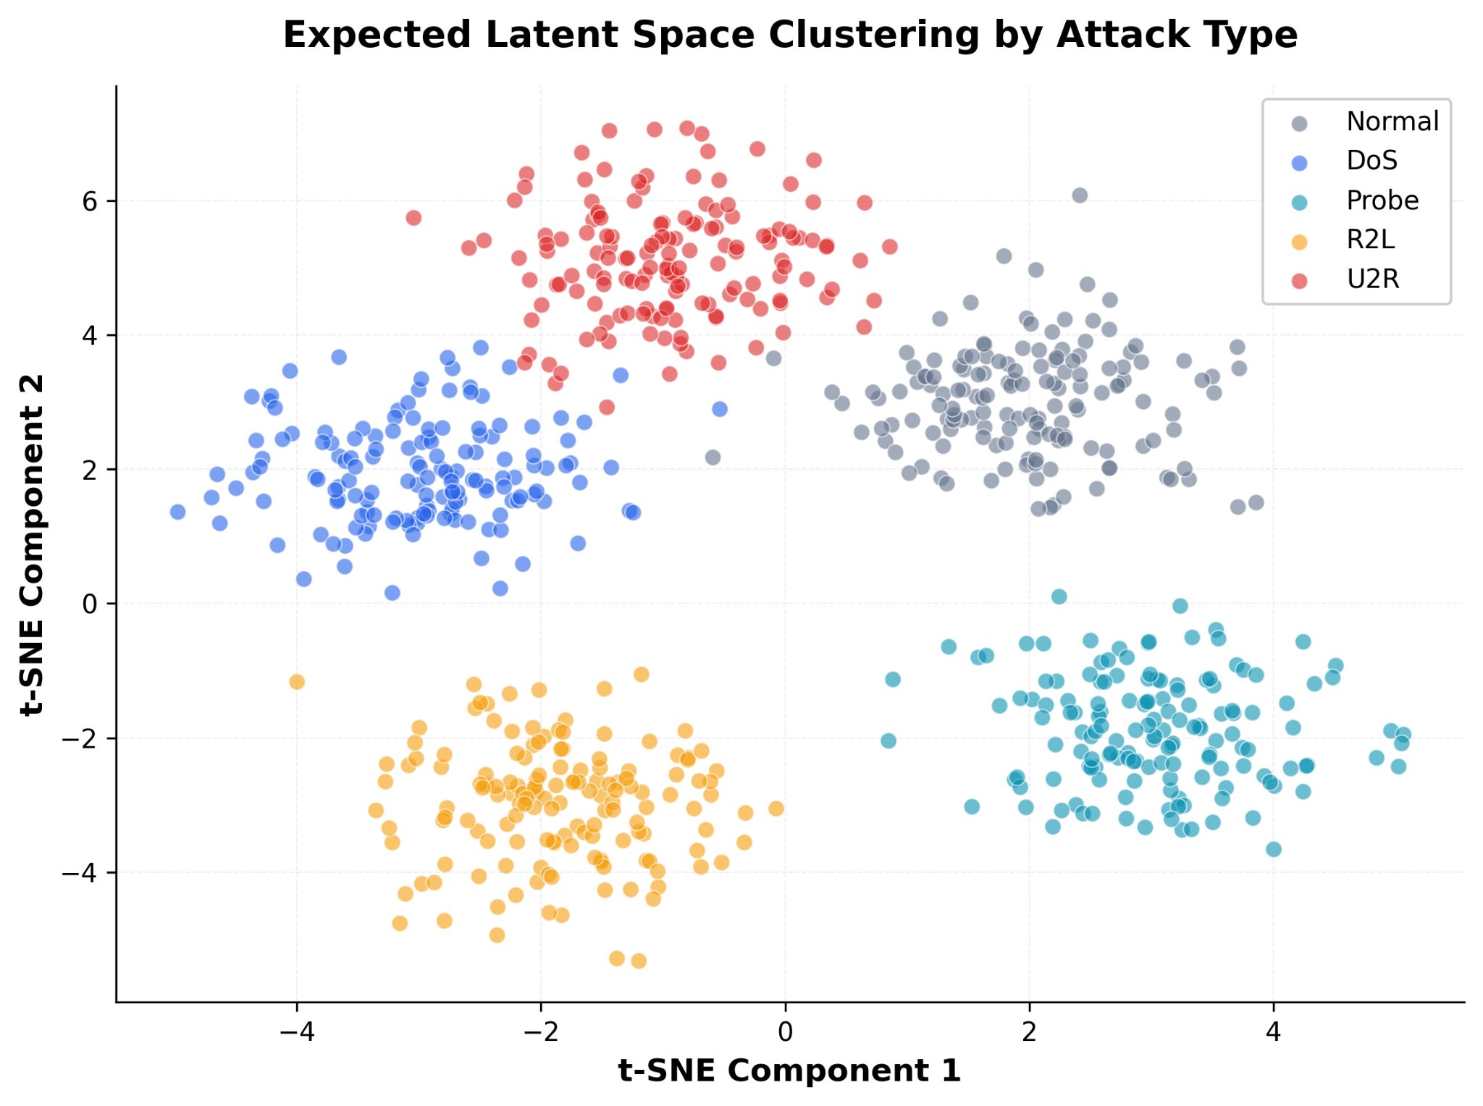
Specific Expectations
Random Noise (z)
+ Condition Label
DoS
Generator Network
Synthetic DoS Samples
Realistic attack features
Notes:
Richard
We expect that both C-VAE and C-GAN can learn to generate network attacks that are both realistic and controllable - meaning when we ask for a DoS attack, it actually generates DoS patterns, not Probe patterns.
We expect to see clear clustering in the latent space where different attack types separate cleanly. The key test is whether a separate classifier trained on real data can correctly identify the synthetic attacks with over 80% accuracy.
Conditional generation will maintain attack-specific statistical properties, like packet rates and protocol distributions.

Slide 6
Reasons for Experimentation
Unknown Factors:
Best conditioning mechanism (concatenation? multiplication?)
Quality vs diversity trade-off in security domain
Will GAN advantages transfer from images to network data?
How to evaluate "realism" for tabular security features?
Comparison Focus:
C-VAE: Stable training, full mode coverage
C-GAN: Higher quality, potential mode collapse
 | C-VAE | C-GAN
Training stability | ✓ | ?
Sample quality | ? | ✓
Diversity | ✓ | ?
Mode coverage | ✓ | ?
Notes:
Richard
This needs experimentation because we can't just assume that what works for images will work for network security data.
There are real open questions: How should we inject the conditioning information - concatenate it with the input, or use it differently? Will GANs have the same quality advantage on tabular network features as they do on images?
And there's the classic GAN problem - will mode collapse hurt us, causing the generator to only learn a few attack patterns instead of the full diversity?
C-VAE should be more stable and cover all modes, but C-GAN might produce more realistic samples. The only way to know is to implement both and compare them systematically on actual security data.

Slide 7
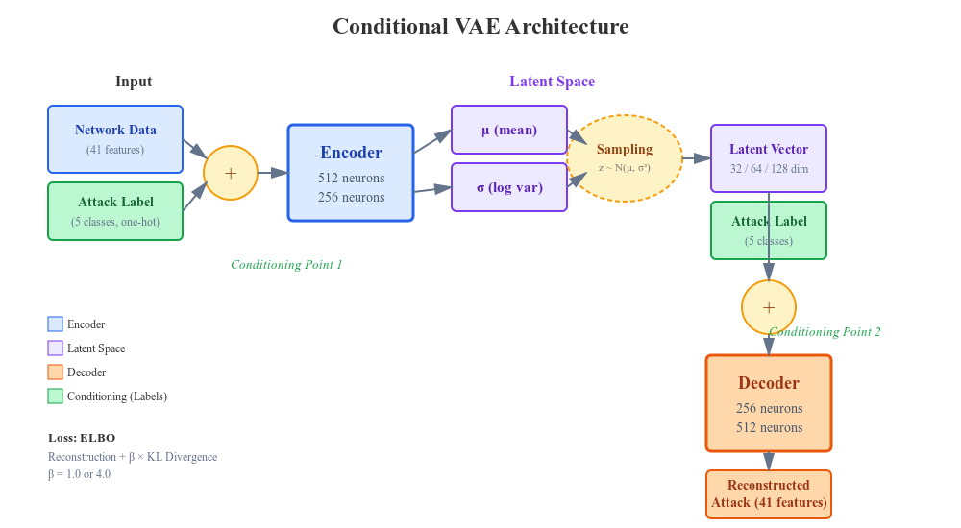
Experimental Setup (C-VAE Architecture)
Notes:
Tania
For the C-VAE architecture, We are building on what we implemented in homework. The key difference is conditioning - we will concatenate the one-hot encoded attack label with the input data before the encoder, and again concatenate it with the latent vector before the decoder. This tells the model what type of attack to generate. Then we will test three latent dimensions - 32, 64, and 128 - to see which gives the best reconstruction and latent space organization. We would also try two beta values: standard VAE with beta equals 1, and beta equals 4 for stronger disentanglement, similar to what we explored in class. Training will use Adam with learning rate 0.001, which worked well in our assignments.

Slide 8
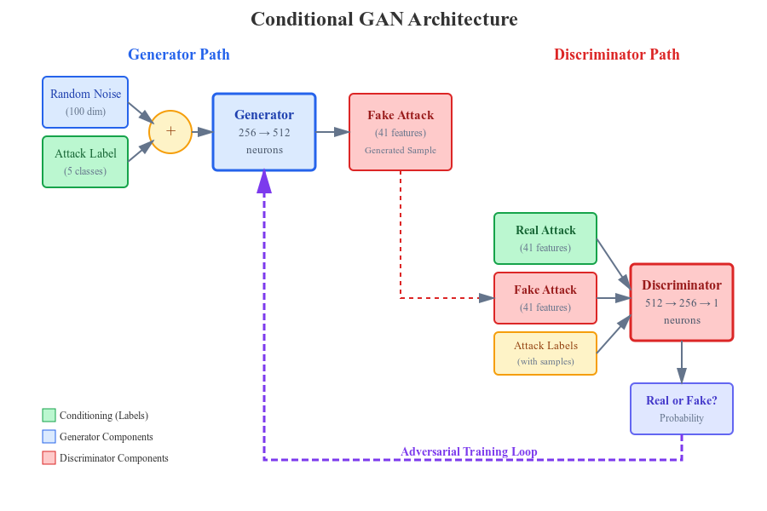
Experimental Setup (C-GAN Architecture)
Notes:
Tania
The C-GAN follows the conditional GAN framework from lecture. The generator takes random noise and the target attack label, then generates a fake attack of that type. The discriminator receives both real and fake attacks along with their labels, and has to decide if each sample is real or fake. The key is that both networks see the conditioning label, so the discriminator can't just say 'this is fake' - it has to evaluate whether it's a realistic example of THAT specific attack type. This creates stronger pressure for the generator to learn type-specific patterns. We are using the standard GAN learning rate of 0.0002, which is lower than VAE because GANs are more sensitive to learning rate

Slide 9
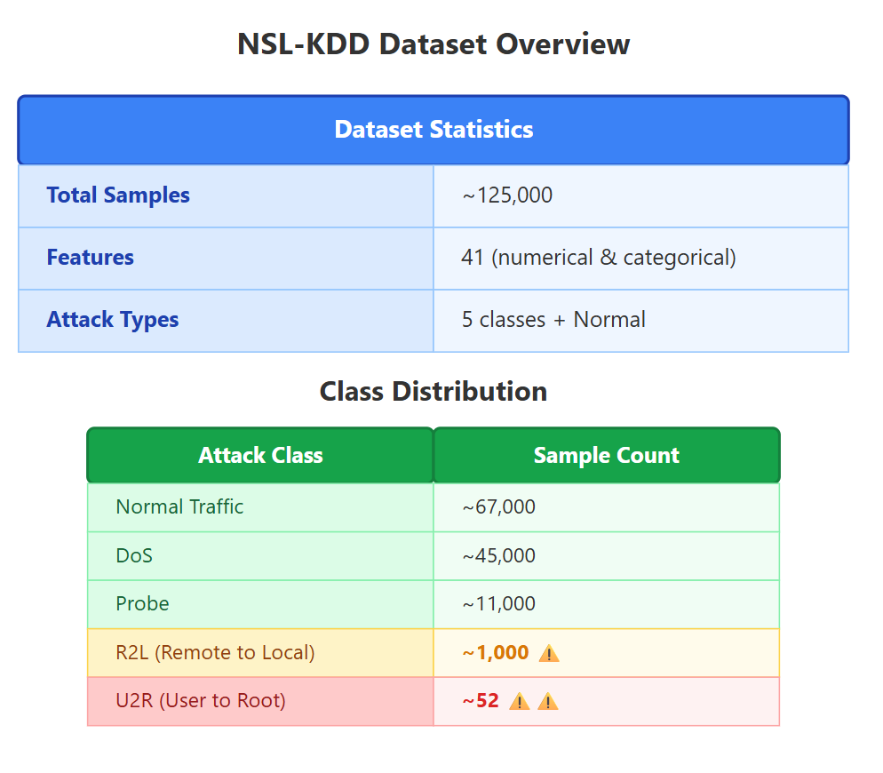
Dataset Specifications
Primary Dataset: NSL-KDD
Why is NSL-KDD appropriate?
Multi-class attack classification aligns with conditional generation goals
Sufficient samples per class for training and validation
Well-studied benchmark enables comparison with prior work
Numerical features suitable for continuous generative models
Notes:
Richard
For our dataset, we’re using NSL-KDD, which is a well-established benchmark for network intrusion detection.
It has about 125,000 samples with 41 features describing network connections - things like packet rates, protocols used, error rates, and connection flags. There are five categories: normal traffic, plus four attack types.
The dataset has massive class imbalance here - normal traffic dominates with around 67,000 samples, and DoS attacks have about 45,000, but User-to-Root attacks have only 52 samples. This is exactly the problem we're trying to solve.
The dataset is already cleaned, which saves time, and we will standardize all numerical features and one-hot encode categoricals like protocol type. This preprocessing gives us a consistent input format for both the VAE and GAN.

Slide 10
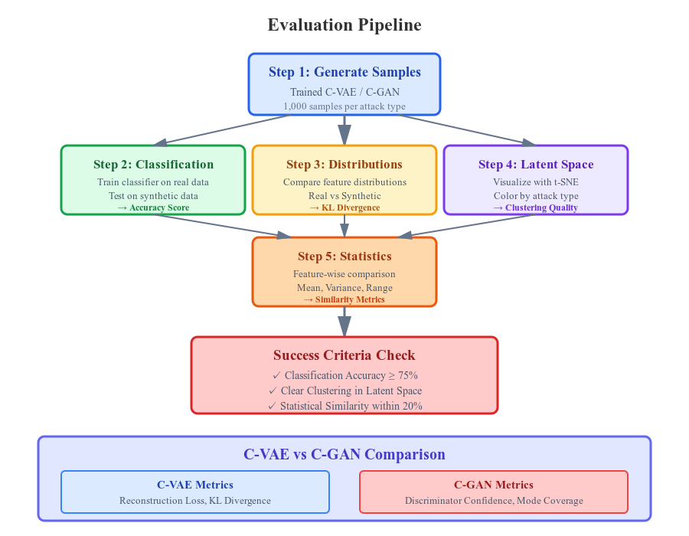
Evaluation Metrics
Reconstruction Quality (VAE)
MSE, Feature-Wise Correlation
Generation Quality
Train classifier on real data, test on synthetic.
Feature distribution comparison (KL divergence).
Per-attack-type confusion matrix.
Diversity
Intra-class variance, latent space coverage.
Latent Space Organization
t-SNE visualization by attack type.
Conditional Accuracy
Proportion of samples correctly classified as target type.
Notes:
Tania
Evaluation is tricky because unlike images, we can't just look at network data and say 'that looks real.' So we will be using multiple metrics. First, we willl train a simple classifier on real data, then test it on the generated samples - if it can correctly identify the attack types with over 75% accuracy, that means the synthetic data has learned the right patterns. Second, we willl compare feature distributions between real and generated data using KL divergence and basic statistics. Third, we will alsol visualize the latent space with t-SNE to see if different attack types cluster separately, which would show the model learned meaningful structure. Finally, weill compare C-VAE and C-GAN directly - looking at reconstruction quality for VAE, and discriminator confidence for GAN. We are also checking for mode collapse in the GAN by measuring diversity within each attack class.

Slide 11
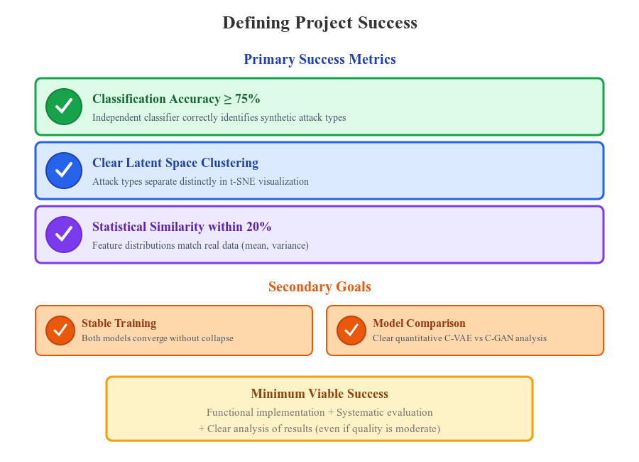
Defining Project Success Criteria
Notes:
Richard
Success for this project has clear, measurable criteria.
The main goal is 75% classification accuracy - meaning if we train a classifier on real data and test it on our synthetic attacks, it should correctly identify attack types at least 75% of the time. This proves the generated data learned meaningful patterns.
Second, we need to see clear clustering in the latent space when visualized with t-SNE. Different attack types should form distinct groups.
Third, statistical properties like mean and variance for each feature should match real data within 20%.
Beyond these primary metrics, we also want stable training for both models and a clear comparison showing their relative strengths.
But honestly, even if generation quality is just moderate, the project succeeds if we demonstrate functional implementation, rigorous evaluation methodology, and thoughtful analysis of what worked and what didn't. The learning process matters as much as perfect results.

Slide 12
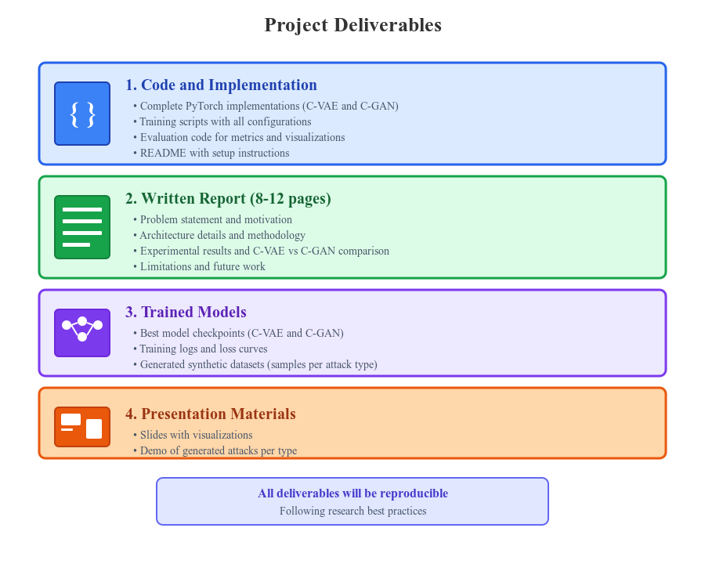
What Will Be Submitted
Notes:
Tania
For deliverables, we will be submitting a complete package. First, all the code - fully functional PyTorch implementations of both Conditional VAE and Conditional GAN, with training scripts that reproduce our results and evaluation code for all the metrics we discussed. Everything will have a clear README so someone could actually run this. Second, a written report between 8 and 12 pages covering the full project - problem motivation, technical details of the architectures, all experimental results with analysis, and an honest discussion of limitations and what we’d do differently next time. The report will have a dedicated section comparing C-VAE versus C-GAN performance across all metrics. Third, we’ll save the trained model checkpoints for the best performing configurations of each model, along with training logs and sample synthetic datasets. And finally, these presentation slides with all the visualizations. The goal is that everything is reproducible and well-documented, following good research practices.

Slide 13
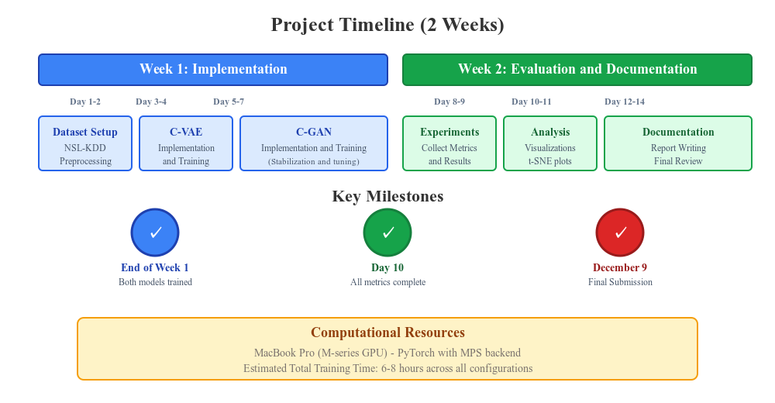
Project Timeline
Notes:
Richard
Here is our two-week timeline:
Week one is all implementation.
We will spend the first two days getting the NSL-KDD dataset preprocessed and the environment set up.
Days three and four are for implementing and training the Conditional VAE, which should be straightforward thanks to the homework.
Days five through seven we’ll implement and train the Conditional GAN - this will take a bit longer because GANs are trickier to stabilize.
Week two shifts to evaluation and documentation.
Days eight and nine we’ll run all the experiments and collect metrics like classification accuracy, latent space visualizations, and distribution comparisons.
Days ten and eleven are for deep analysis and creating all the visualizations like t-SNE plots and feature distribution charts.
The last few days are for writing the report and polishing the presentation.
Our key milestones are: By end of week one, both models should be trained. By day ten, all evaluation should be done. And our final submission is on December 9th.
This timeline is aggressive but doable, and we have built in a little buffer in the documentation phase in case training takes longer than expected.
Now, we’re happy to take any questions or feedback you might have.

Slide 14
Thank you!
Questions?

Slide 15
References
Takyar, Akash. Generative-Adversarial-Networks. LeewayHertz, https://d3lkc3n5th01x7.cloudfront.net/wp-content/uploads/2023/03/28045210/Generative-Adversarial-Networks-5.png.

